Slide 1

Lightning sidebridge for web3
Survey of Literature Presented By
Deep Mahajan
Bhavesh Nikam
3. Rushikesh Badgujar
4. Piyush Sharma
Co-Guide
Dr. Makarand Shahade
Guided By
Prof. Mayuri Kulkarni
Department of Computer Engineering
B. Tech Computer Academic Year 2023-2024 Sem - VII

Slide 2
Outline
1.Introduction & Motivation
2.Literature Survey
3.Limitation & Future scope in Existing System
4.Proposed System 5.Tools & Technologies to be used
6.Conclusion
7.References
Dept of Computer Engg. SVKM IOT Dhule

Slide 3
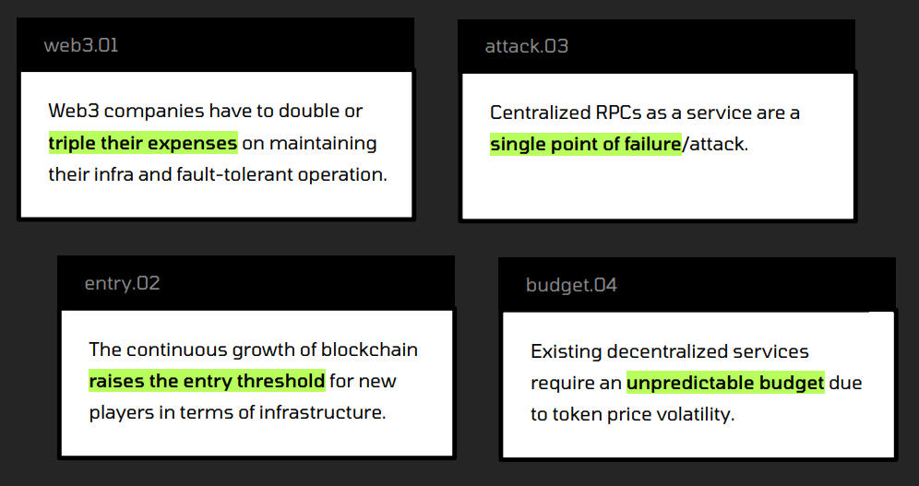
Introduction & Motivation
The Lightning sidebridge for web3 is Project Based on
the core Infrastructure of Blockchain. Which eliminates Centralized RPC Mechanism and improve web3 Services for Decentralized apps.
Dept of Computer Engg. SVKM IOT Dhule

Slide 4
Literature Survey
No. | Paper Name | Author Name | Technology Used | Short Description | Limitations and Challenges
1 | A Decentralised Remote Procedure Call Transaction Manager | Wanlei Zhou (1992) | Decentralized systems, Remote Procedure Call | The paper proposes a decentralized approach for managing remote procedure call transactions. It focuses on handling distributed transactions efficiently and ensuring reliable communication between different nodes. | Limitations might include scalability issues in very large networks, potential security vulnerabilities in the decentralized communication model.
2 | DC-PoET: Proof-of-Elapsed-Time Consensus with Distributed Coordination for Blockchain Networks | Amitangshu Pal and Krishna Kant (2021) | Blockchain, Proof-of-Elapsed-Time (PoET) | The paper introduces a consensus mechanism called DC-PoET, which utilizes distributed coordination to enhance the Proof-of-Elapsed-Time consensus in blockchain networks. | Challenges could involve optimizing the coordination process to minimize resource consumption and potential trade-offs between security and efficiency.
Dept of Computer Engg. SVKM IOT Dhule

Slide 5
3 | Feature Extraction of Network Traffic in Ethereum Blockchain Network Layer for Eclipse Attack Detection | Dhanasak Bhumichai and Ryan Benton (2023) | Ethereum, Network Traffic Analysis | The paper focuses on detecting Eclipse attacks in the Ethereum blockchain network by extracting features from network traffic data. It aims to enhance the security of the network against this specific type of attack. | Challenges may include accurately distinguishing legitimate network behavior from attack patterns and adapting the detection mechanism to evolving attack strategies.
4 | Ethereum: A Next-Generation Smart Contract and Decentralized Application Platform | Whitepaper by Ethereum Team (Updated 2023) | Ethereum, Smart Contracts, Decentralized Applications | The Ethereum whitepaper outlines the design and capabilities of the Ethereum platform, which enables the creation of smart contracts and decentralized applications. It introduces the concept of the Ethereum Virtual Machine (EVM). | Limitations can involve scalability concerns due to network congestion and high gas fees, as well as the challenge of maintaining security and preventing vulnerabilities in smart contracts.

Slide 6
4 | Ethereum: A Next-Generation Smart Contract and Decentralized Application Platform | Whitepaper by Ethereum Team (Updated 2023) | Ethereum, Smart Contracts, Decentralized Applications | The Ethereum whitepaper outlines the design and capabilities of the Ethereum platform, which enables the creation of smart contracts and decentralized applications. It introduces the concept of the Ethereum Virtual Machine (EVM). | Limitations can involve scalability concerns due to network congestion and high gas fees, as well as the challenge of maintaining security and preventing vulnerabilities in smart contracts.
5 | Solana: A new architecture for a high performance blockchain v0.8.13 | Solana Team (Updated 2022) | Solana Blockchain Architecture | The paper presents the Solana blockchain's architecture, emphasizing its high performance and scalability features. It introduces concepts like Proof-of-History and Tower BFT consensus. | Challenges include validating the performance claims under various network conditions, ensuring decentralization as the network scales, and addressing any potential vulnerabilities in the novel architecture.

Slide 7
Limitation and future scope in Existing System
A Decentralised Remote Procedure Call Transaction Manager
Limitations:
Scalability might be a challenge when dealing with a large number of nodes and transactions in the decentralized network.
Ensuring security and preventing malicious activities within a decentralized communication model can be complex.
Future Scope:
Research and development in optimizing the protocol for handling larger networks and higher transaction volumes.
Exploration of techniques to enhance the security of the decentralized communication model.
DC-PoET: Proof-of-Elapsed-Time Consensus with Distributed Coordination for Blockchain Networks
Limitations:
Resource consumption due to distributed coordination might hinder the efficiency gains of the PoET consensus mechanism.
Balancing the trade-off between security and efficiency requires further investigation.
Future Scope:
Further optimization of the coordination process to minimize resource consumption while maintaining security guarantees.
Research into adapting the coordination mechanism to different network sizes and configurations.
Dept of Computer Engg. SVKM IOT Dhule

Slide 8
3. Feature Extraction of Network Traffic in Ethereum Blockchain Network Layer for Eclipse Attack Detection
Limitations:
False positives/negatives in eclipse attack detection due to the complexity of distinguishing legitimate network behavior from attacks.
Effectiveness of the feature extraction technique may vary depending on the nature of the attack and network conditions.
Future Scope:
Refinement of feature extraction methods to improve accuracy in detecting eclipse attacks.
Development of adaptive detection mechanisms that can evolve with emerging attack strategies.
4. Ethereum: A Next-Generation Smart Contract and Decentralized Application Platform
Limitations:
Scalability issues resulting in network congestion and high gas fees during periods of high demand.
Vulnerabilities and security risks in smart contracts that can lead to exploits and loss of funds.
Future Scope:
Continued research and implementation of Ethereum 2.0 to address scalability concerns through the transition to a Proof-of-Stake consensus mechanism.
Ongoing efforts to enhance the security of smart contracts, including formal verification techniques and improved development practices.

Slide 9
5. Solana: A new architecture for a high performance blockchain v0.8.13
Limitations:
The real-world performance of the Solana architecture may vary from the theoretical claims, especially under varying network conditions.
Ensuring decentralization as the network scales can be challenging.
Future Scope:
Empirical validation and benchmarking of the Solana network's performance and scalability claims.
Research and development to maintain decentralization while accommodating a growing number of nodes and transactions.

Slide 10
Proposed System
Problem Statement: To Design a Smart Contract for Sidebridge client Services in web3 to improve & Enhance the services of Decntralized Applications.
Objective:
1. Side bridge for Decentralized apps
2. Decentralized RPC service for Web3
3. Speed Up Transactions
4. Cost Reduction in Maintenance of Nodes
5. Avoid Single Point Failure
6. Avoid Fault Tolerance
Dept of Computer Engg. SVKM IOT Dhule

Slide 11
Tools & Technologies to be used
Technologies :
1. Blockchain
2. web3
Tools :
1. Phantom wallet
2. Rust
3. Go
4. Openzepline
5. Atom
6. Spacemacs
Dept of Computer Engg. SVKM IOT Dhule

Slide 12
Focus on Proposed Methodology
Step1 : Deploy a smart contract to connect public decentralized nodes.
Step 2: For Validation purpose deploy proof of elapsed time consensus for validators.
Step 3: prevention of eclipse attack solve the problem of double spending.
Step4 : Test the Transaction by connecting Web3 Wallet to Smart Contract.
Dept of Computer Engg. SVKM IOT Dhule

Slide 13
Project Progress Timeline
Phase 1 : Identify & Design solution for problem statement.
Phase 2 : Deploy a smart contract on Blockchain using Rust and Go.
Phase 3 : Connect a smart contract to wallet and GUI.
Phase 4 : Testing the Project with respect to current system limitations.
Dept of Computer Engg. SVKM IOT Dhule

Slide 14
Conclusion
The proposed idea is aiming to solve the problem of
Single point failure by Eliminating Centralized RPC.
Removing Eclipse Attack and Double Spending using proof of elapsed time (PoET).
Reducing High Expense cost on web3 services (Maintenance of Nodes).
Speeding up decentralized apps on web3 infrastructure.
Dept of Computer Engg. SVKM IOT Dhule

Slide 15
References
1. A Dcentralised Remote Procedure Call Transaction Manager by Wanlei zhou (1992)
Link : https://ieeexplore.ieee.org/document/271947/
2. DC-PoET: Proof-of-Elapsed-Time Consensus with Distributed Coordination for Blockchain Networks by
Amitangshu Pal and Krishna Kant. (2021)
Link : https://ieeexplore.ieee.org/document/9472787/
3. Feature Extraction of Network Traffic in Ethereum Blockchain Network Layer for Eclipse Attack Detection
Dhanasak Bhumichai and Ryan Benton (2023)
Link : https://ieeexplore.ieee.org/document/10115068/
Dept of Computer Engg. SVKM IOT Dhule

Slide 16
4. Ethereum: A Next-Generation Smart Contract and Decentralized Application Platform (Februari 9, 2021) (Updated 2023)
WhitepaperLink: https://whitepaper.io/document/718/ethereum-whitepaper
5. Solana: A new architecture for a high performance blockchain v0.8.13 (updated 2022)
Link : https://whitepaper.io/document/602/solana-whitepaper

